Slide 1
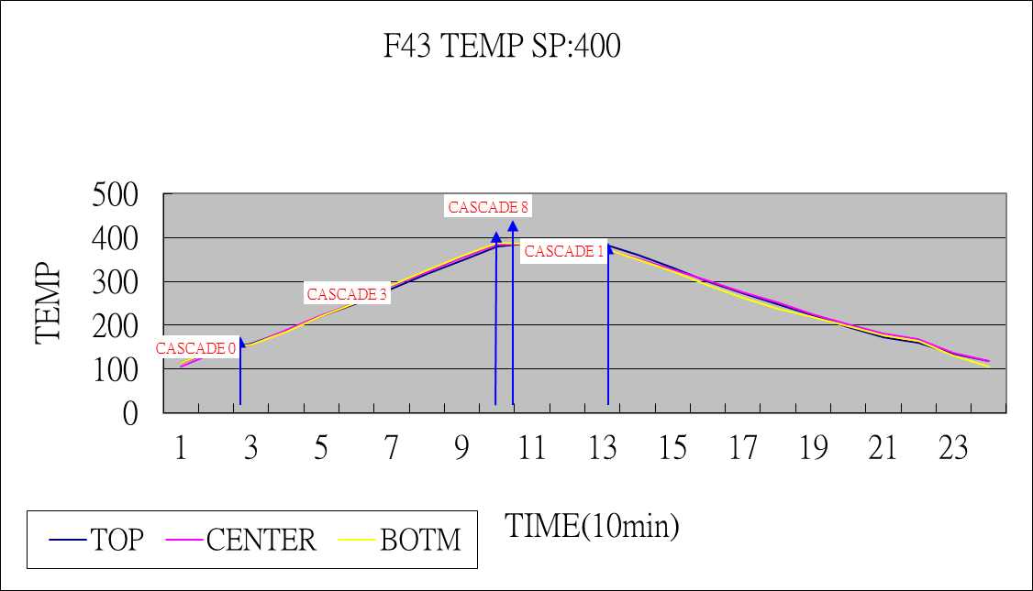
Cascade(0): Stand by
Cascade(3): 升溫
Cascade(8): Damping
Cascade(1): 穩定

Slide 2
F43 Koyo Furnace recipe (PI 115A)
Step. | INST | VALUE 1 | VALUE 2 | Step. | INST | VALUE 1 | VALUE 2
1 | CASCT |  |  | 26 | PIDM | 1
2 | PIDM | 0 |  | 27 | WAIT | 0h25m0s
3 | T1 |  |  | 28 | TMP | 256 | 3(1.6)
4 | TMP | 140 | 0 | 29 | WAIT | 0h5m0s
5 | WAIT | 0h0m15s(2h) |  | 30 | V14 | ON
6 | CTO |  |  | 31 | WAIT | 0h0m40s
7 | CTI |  |  | 32 | T2
8 | BED |  |  | 33 | WAIT | 0h3m0s
9 | SHC |  |  | 34 | V14 | ON
10 | WAIT | 0h0m15s |  | 35 | WAIT | 0h0m20s(40s)
11 | LD |  |  | 36 | T2
12 | SHO |  |  | 37 | WAIT | 0h3m0s
13 | BEU |  |  | 38 | TMP | 140 | 3(3.5)
14 | PIDM | 0 |  | 39 | PIDM | 2
15 | WAIT | 0h0m3s |  | 40 | T6
16 | TMP | 165 | 3 | 41 | WAIT | 0h0m3s
17 | WAIT | 0h5m0s(10m) |  | 42 | PIDM | 0
18 | T2 |  |  | 43 | T1
19 | O2CHK | 0h25m0s(20m) | 0 | 44 | BED
20 | WAIT | 0h0m1s |  | 45 | SHC
21 | PIDM | 3 |  | 46 | WAIT | 0h10m0s
22 | TMP | 400 | 3 | 47 | ULD
23 | WAIT | 0h0m1s |  | 48 | CTO
24 | PIDM | 8 |  | 49 | SHO
25 | WAIT | 0h5m0s |  | 50 | BEU
 |  |  |  | 51 | END

Slide 3
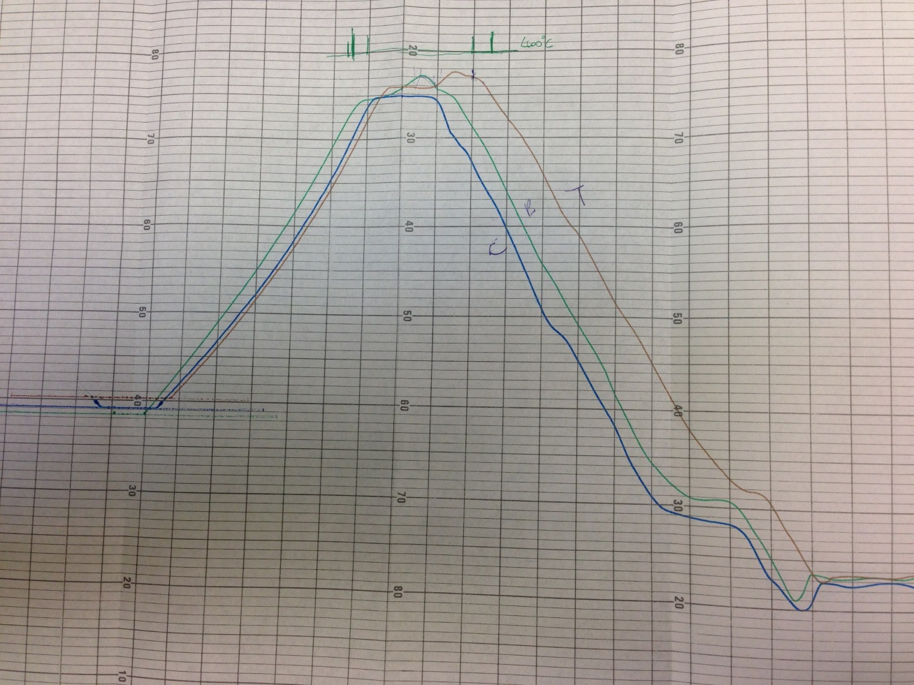
1. 大夜調整後test run:
adj 400度CEN電壓:14.6→15.1(re cen:350)
adj cascade(1):-80/-190/-120→-80/-150/-120
adj cascade(3):-80/-190/-120→-80/-150/-120
反應步驟 step.27 約剩5分鐘 SP:400 PV: ( 404.9/367.2/402.7 )
B & C升溫太慢.

Slide 4
2.
adj cascade(0):-58/-130/-120 => -60/-60/-60
adj cascade(3):-80/-150/-120 => -80/-80/-80
adj cascade(8):-80/-190/-130 => -90/-190/-140
TEST RUN
升溫步驟 step.23 即可到達目標值 但damping太大
SP: 380.0/380.1/380.0
PV: 379.8/390.8/398.4
(B & C 升溫過快)
3.
adj cascade(1):-80/-150/-120 => -80/-100/-100
adj cascade(3):-80/-80/-80 => -80/-100/-110
adj cascade(8):-90/-190/-140 => -90/-120/-120
Test run again.

Slide 5
F43 Cascade 目前設定
Cascade | Top | Cen | Btn
0 | -60 | -60 | -60
1 | -80 | -100 | -100
2 | -270 | -260 | -240
3 | -80 | -100 | -110
4 | -60 | -85 | -50
5 | -70 | -70 | -65
6 | -240 | -310 | -230
7 | -50 | -60 | -60
8 | -90 | -120 | -120
9 | -35 | 0 | -60

